Slide 1



Slide 2


Slide 3
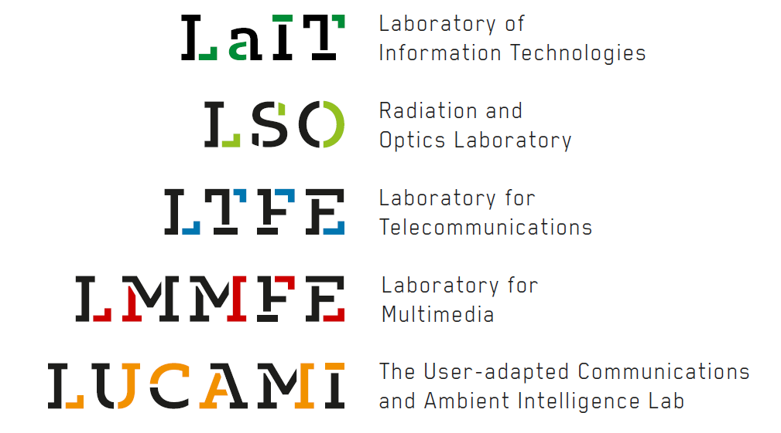

Slide 4
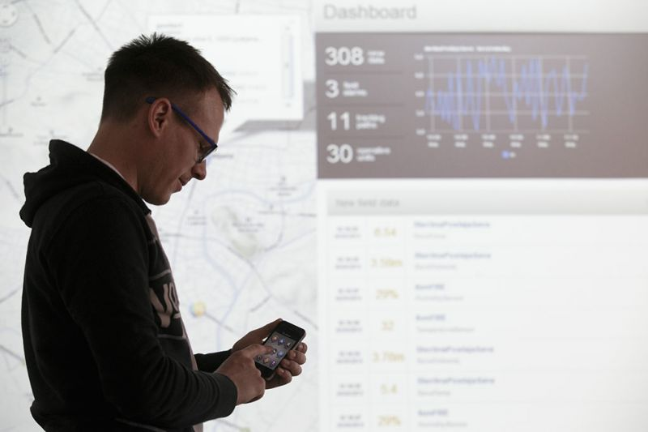

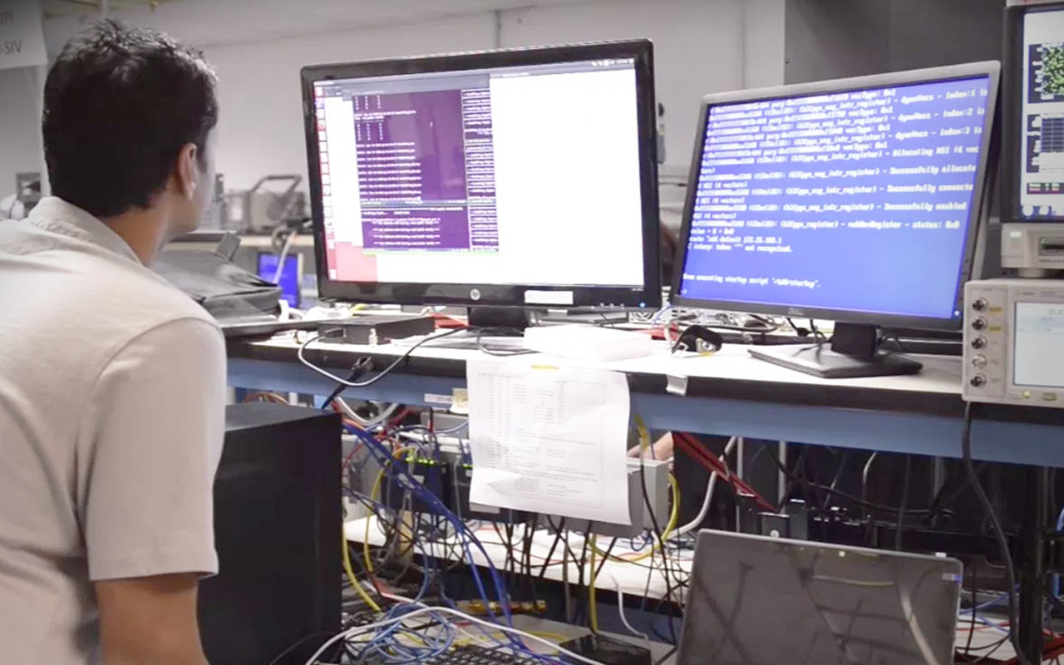
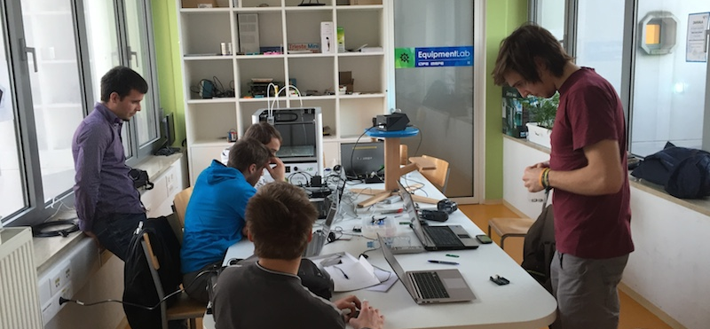

Slide 5
Communication Systems
Continuous Signals and Systems
Optical communications
Inforamtion and communication systems security
Software for communications systems
High-frequency technology
Information Theory and Source Coding
Electrodynamics
Digital signal and video processing
Design and management of communication systems
Internet Networks I
Operations research in telecommunications
Digital Communication
Intelligent Systems
Telecommunication Protocols
Digital Signal Processing
Information Systems
Antennas and wave propagation
Internet services and application
Satellite Communication and Navigation

Slide 6
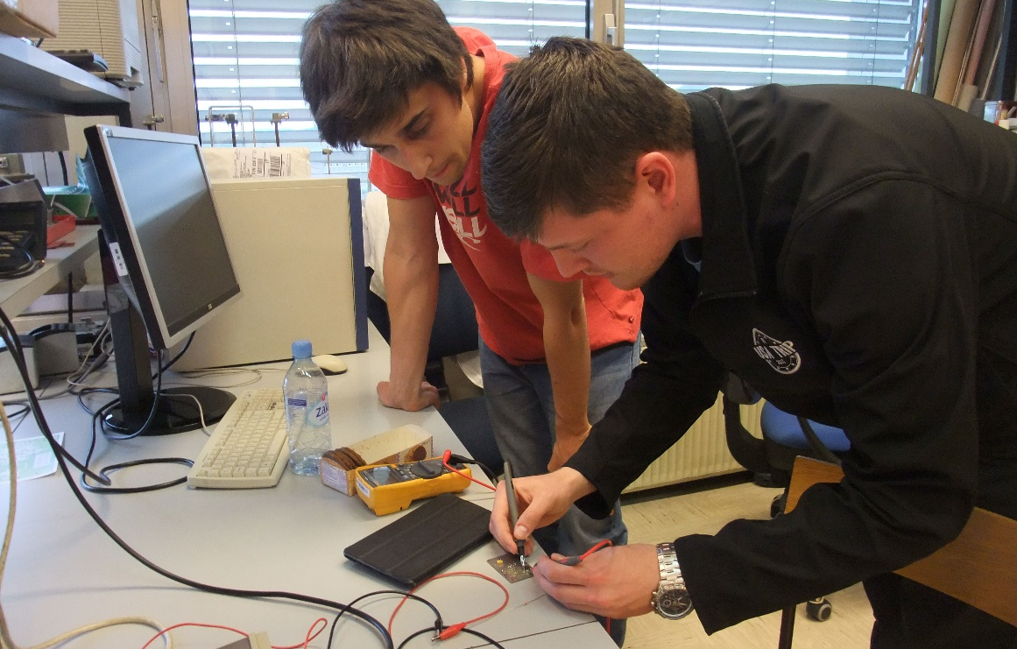
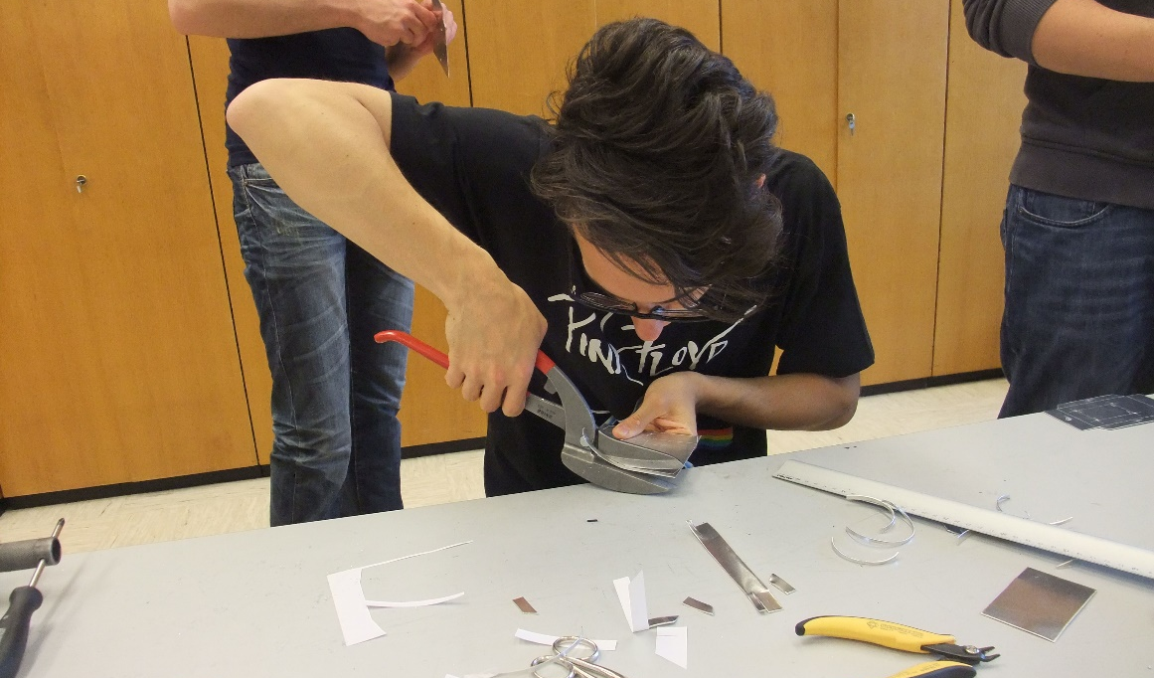
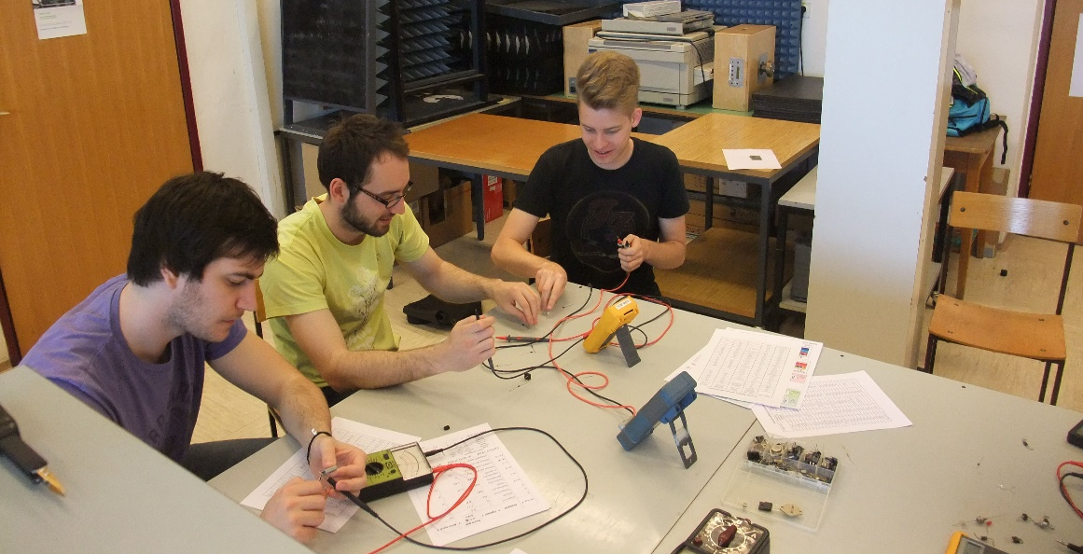
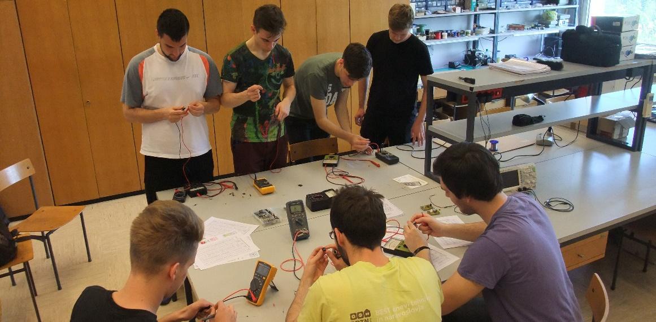

Slide 7
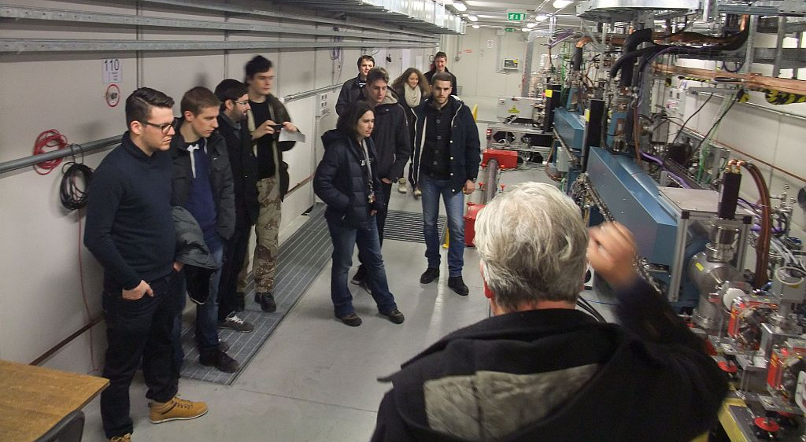
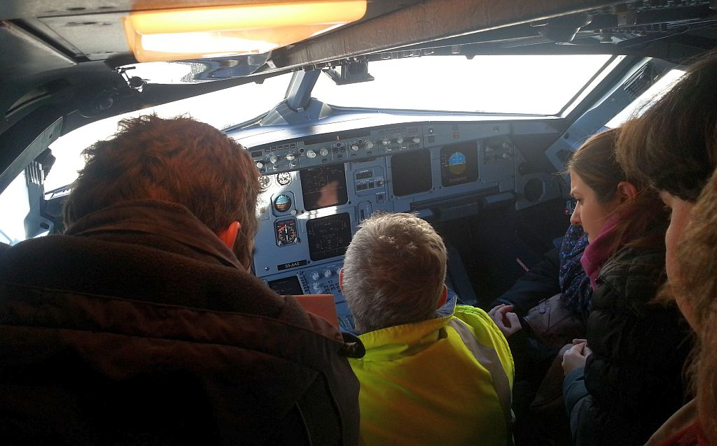

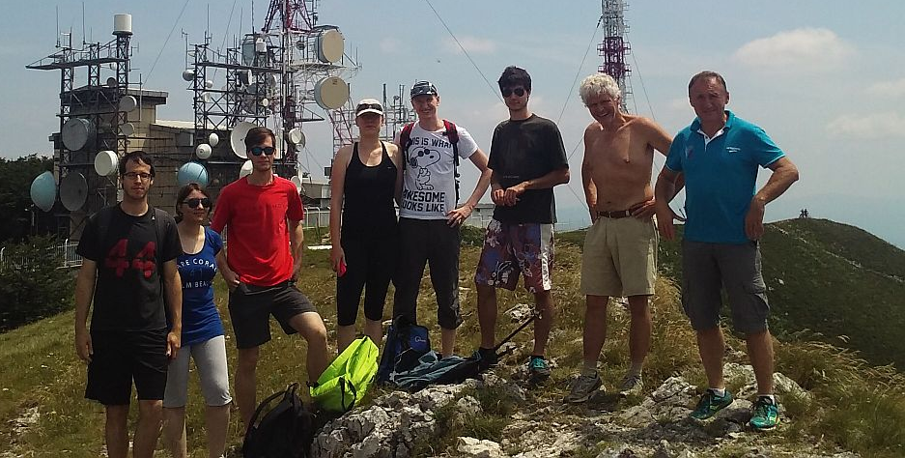

Slide 8












From theory
to practice

